Slide 1


Single file applications
Harishchandra Ukirade

Slide 2
Agenda
What is .NET?
.NET versions
Deployment modes
Single file applications
Commands
Project configurations
Publish
Demo
Q&A

Slide 3

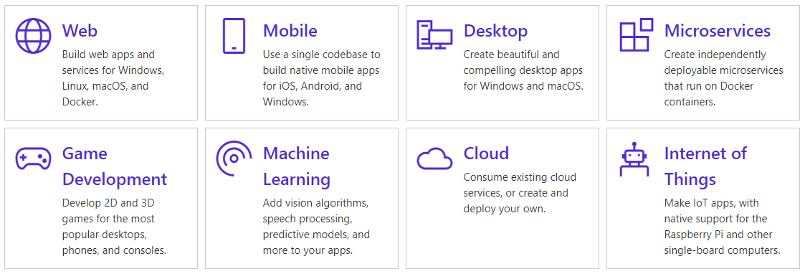
.NET core
.NET is a free, cross-platform, open source developer platform for building many different types of applications.
With .NET, you can use multiple languages, editors, and libraries to build for web, mobile, desktop, games, and IoT.

Slide 4

.NET versions
November 2020
.NET core 1.x
.NET core 2.x
.NET 5
.NET core 3.x
September 2019
August 2017
June 2016
Single file application
In memory dependencies
Single file application
Dependencies with separate folder
Self-contained deployment

Slide 5



Deployments Modes
Framework-dependent deployment (FDD)
Framework-dependent deployment mode applications are completely dependent upon the .NET Core installed on the target machine where you want to deploy your app.
Self-contained deployment (SCD)
Self-contained deployment (SCD) does not use the common .NET Core install on the server. The final application build contains all the app-specific code and its dependencies along with .NET Core libraries and .NET Core runtime.
Framework-dependent executable (FDE)
This mode is included form .NET Core 2.2. It is exactly same as FDD but this mode produces the executable that can be run on any target machine

Slide 6
Self-contained deployment (SCD)
As the name specifies, Self-contained deployment (SCD) does not use the common .NET Core install on the server.
The final application build contains all the app-specific code and its dependencies along with .NET Core libraries and .NET Core runtime.
In this mode, it is not necessary to have .NET Core runtime install on the servers.
As .NET Core is cross-platform, we can build our code depending upon the platform we want to run the app.

Slide 7

Single-file application
Single file applications are published and deployed as a single file. The app and its dependencies are all included within that file. When the app is run, the dependencies are loaded directly from that file into memory. There is no performance penalty with this approach. When combined with assembly trimming and ahead-of-time compilation, single file apps are smaller and startup quickly
.NET Core 3.0 allows you to package an app into a platform-specific single-file executable.
You can generate this executable two ways, both methods require a .NET Core 3.0 project
In .NET 5.0, single file apps are primarily focused on Linux. They can be either framework-dependent or self-contained. Framework-dependent single file apps can be very small, by relying on a globally-installed .NET runtime.

Slide 8

Commands to produce single-file apps
Framework-dependent single-file app:
dotnet publish -r linux-x64 --self-contained false /p:PublishSingleFile=true
Self-contained single-file app with assembly trimming and ready to run enabled:
dotnet publish -r linux-x64 --self-contained true /p:PublishSingleFile=true /p:PublishTrimmed=true /p:PublishReadyToRun=true

Slide 9
Configure publish with a project file
<Project Sdk="Microsoft.NET.Sdk">
<PropertyGroup>
<OutputType>Exe</OutputType>
<TargetFramework>net5.0</TargetFramework>
<!-- Enable single file -->
<PublishSingleFile>true</PublishSingleFile>
<!-- Determine self-contained or framework-dependent -->
<SelfContained>true</SelfContained>
<!-- The OS and CPU type you are targeting e.g. win-x64 -->
<RuntimeIdentifier>linux-x64</RuntimeIdentifier>
<!-- Enable use of assemby trimming - only supported for self-contained apps -->
<PublishTrimmed>true</PublishTrimmed>
<!-- Enable AOT compilation -->
<PublishReadyToRun>true</PublishReadyToRun>
</PropertyGroup>
</Project>

Slide 10
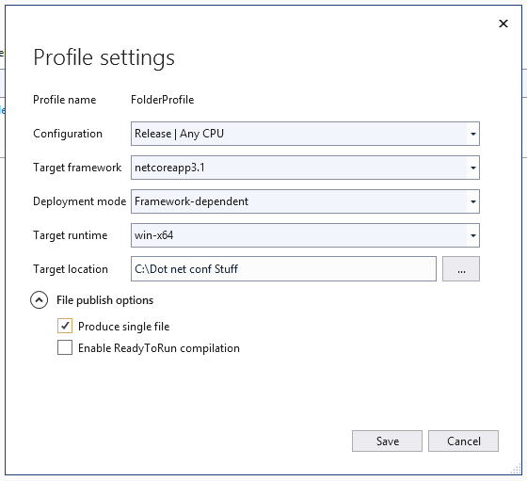
Publish as single file
We can see settings to use while creating a build for app. So now select Framework-dependent as Deployment mode and Target Runtime as win-x64.

Slide 11

Demo
Harishchandra Ukirade

Slide 12
Code Sample
Code sample

Slide 13

Thanks for joining!

